Slide 1
Digital Electronics
Lab *: Binary Arithmetic*

Slide 2


Welcome to Digital Electronics Class

Slide 3

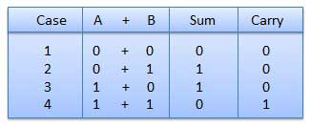
Binary Adding
It is a key for binary subtraction, multiplication, division. There are four rules of binary addition.
In fourth case, a binary addition is creating a sum of (1 + 1 = 10) i.e.
0 is written in the given column and a carry of 1 over to the next column.

Slide 4
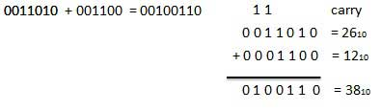
Binary Adding

Slide 5
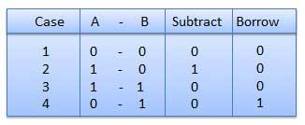
Binary Subtraction
Subtraction and Borrow, these two words will be used very frequently for the binary subtraction. There are four rules of binary subtraction.

Slide 6
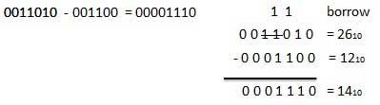
Binary Subtraction

Slide 7
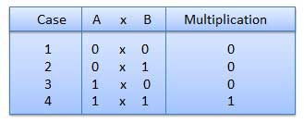
Binary Multiplication
Binary multiplication is similar to decimal multiplication. It is simpler than decimal multiplication because only 0s and 1s are involved. There are four rules of binary multiplication.

Slide 8
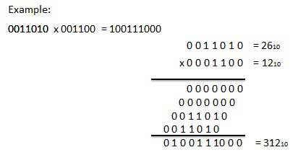
Binary Multiplication

Slide 9
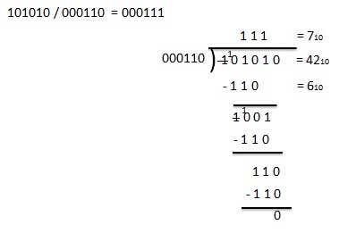
Binary Division
Binary division is similar to decimal division. It is called as the long division procedure.
Example − Division

Slide 10

Thank You!

